Slide 1

Online Doctor Appointment System
TEAM Members:
Shashank.K (UI)
Navya.K (UI,Database)
Divya.A (java,Database)
Vamsi.V (Database)

Slide 2
INTRODUCTION
The Online Doctor Appointment System is a digital platform that enables patients to schedule appointments with doctors online, offering convenience and efficiency.
It maintains records of patient, doctor, appointment and schedule that occur at any of the medical center.
System enables registration of new patient and Doctors are registered by hospital staff.
From the account of user as patient, one can take appointment of a Doctor; can see doctor details and all his appointment date and time.
The proposed system has the following capabilities maintain patient’s records, registering new patients, records of appointment and easy future references.

Slide 3
Objectives of the Project
To make the system simple to use and navigate, provide an intuitive and user-friendly interface for patients and healthcare professionals.
To allow patients to schedule appointments online using their preferred medical professionals, such as general practitioners, experts, and hospitals

Slide 4
LITERATURE
Existing Hospital Appointment Schemes | One application developed to manage patients’ appointment scheduling has used exponential enter arrival times. This model assumes that the exponential enter arrival times could not be directly validated by date, and it is limited due to the nature of the appointment scheduling (Rohleder, 2002). Since appointments are scheduled in the future, the exact model of call arrivals will only have limited impact on measures related to the time between the call and the appointment time. For this reason, the challenge for making appointment system is designing a suitable system based on the health care procedure environment (Klassen, 2002). Hence, the appointment provider in the health care center can schedule a patient into an appropriate time slot on a given day. [The is about web-based appointment systems, which are systems that allow users to book appointments online for various purposes]
Patients’ Appointment System | A patient appointment system or appointment schedule for health care center started long time ago (Harper, 2003). Management of patients’ appointments has earlier works and has developed simplified queuing models and fairly static scheduling conditions. Another attempt was made to calculate the waiting time between patient and doctor using the mathematical queuing models to minimize waiting time (Gamlin, 2003). However; traditionally the appointment system has considered that the doctor time is more important than patient time (Wijewickrama, 2005). So an appointment system was designed to minimize the doctor idle time but current designing of an appointment system is based on decisive factors with respect to both the patient and doctor [they did not care much about the patient’s time. They only wanted to make sure that the doctor was not wasting time. It says that now people are trying to make a system that is good for both the patient and the doctor. blocking appointements](Takakuwa, 2005).
Managing Patients’ Appointment system | According to Dexter (1999), managing patient appointment system is a computer application used to manage and reduce the patient waiting time in the health care center. Some health care centers do not use any appointment system. So it has a longer average patients’ waiting time than the health care center that adopts the patients’ appointment system[It says that one way to solve this problem is to let the patients come on the same day they call or ask for an appointment. This is called an open access or advanced access policy.].
Online Booking System | An online system is also known as a web based system. A web is made up of page that is commonly known as web page or web site, and a web site is a computer program that runs a webserver that provides access to a group of related web pages (Alex, 2000). A system is a set of in dependent components working together to achieve a common objective[The text argues that this model is not very accurate because appointments are planned in advance and depend on the type of health care service.].
Existing Hospital Appointment Schemes | One application developed to manage patients’ appointment scheduling has used exponential enter arrival times. This model assumes that the exponential enter arrival times could not be directly validated by date, and it is limited due to the nature of the appointment scheduling (Rohleder, 2002). Since appointments are scheduled in the future, the exact model of call arrivals will only have limited impact on measures related to the time between the call and the appointment time. For this reason, the challenge for making appointment system is designing a suitable system based on the health care procedure environment (Klassen, 2002). Hence, the appointment provider in the health care center can schedule a patient into an appropriate time slot on a given day.

Slide 5
Requirements Specification
Patient Registration: Patients are required to sign up, create profiles, and provide all relevant data and credentials.
Doctor Registration: Doctors are required to sign up, create profiles, and provide all relevant data and credentials.
Appointment Scheduling: Patients should have the option of choosing a , a time slot that is open, a doctor and scheduling a visit.
Appointment Management: The flexibility to accept, reschedule, or cancel appointments should be available to doctors as needed.

Slide 6
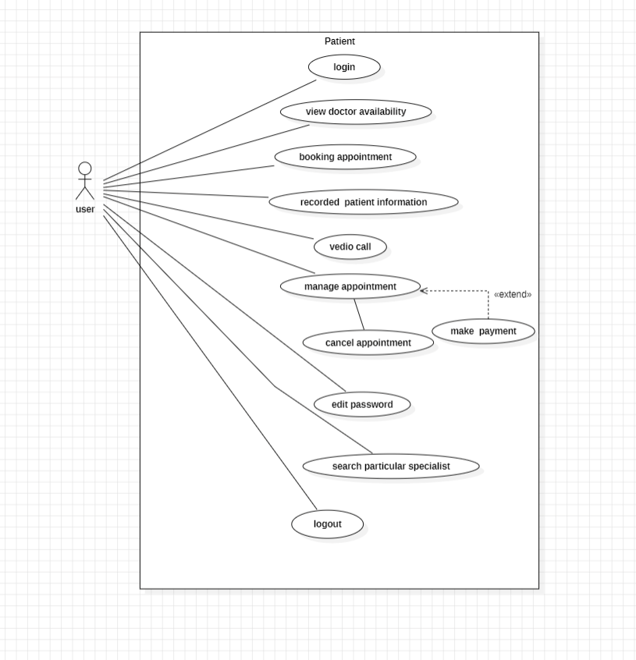
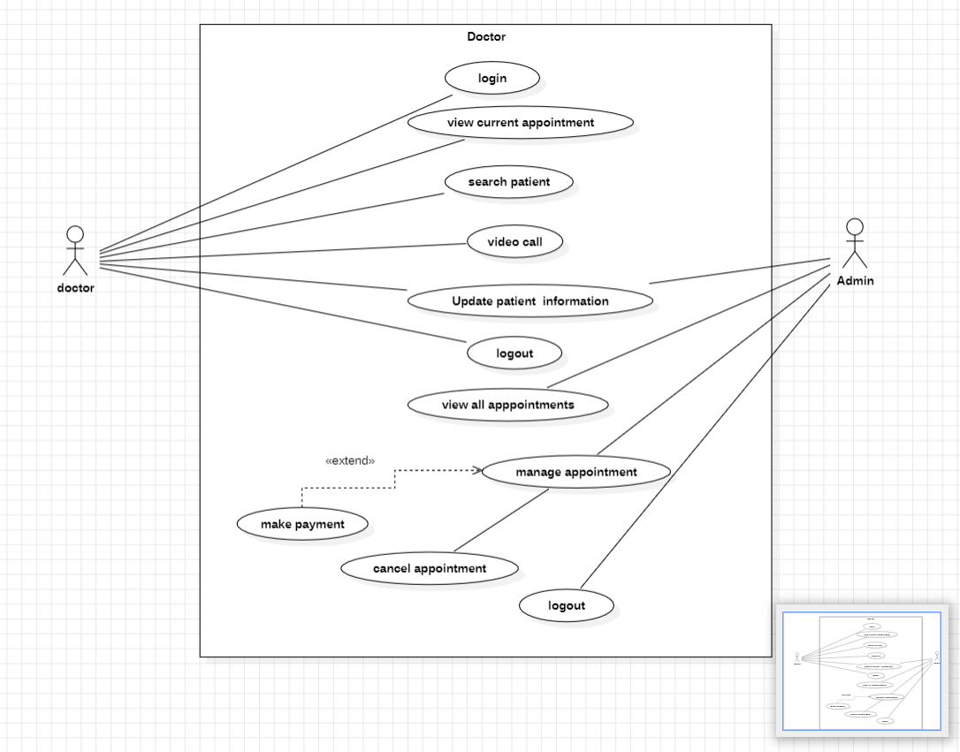
System Design
Doctor Use Case
User Use case

Slide 7
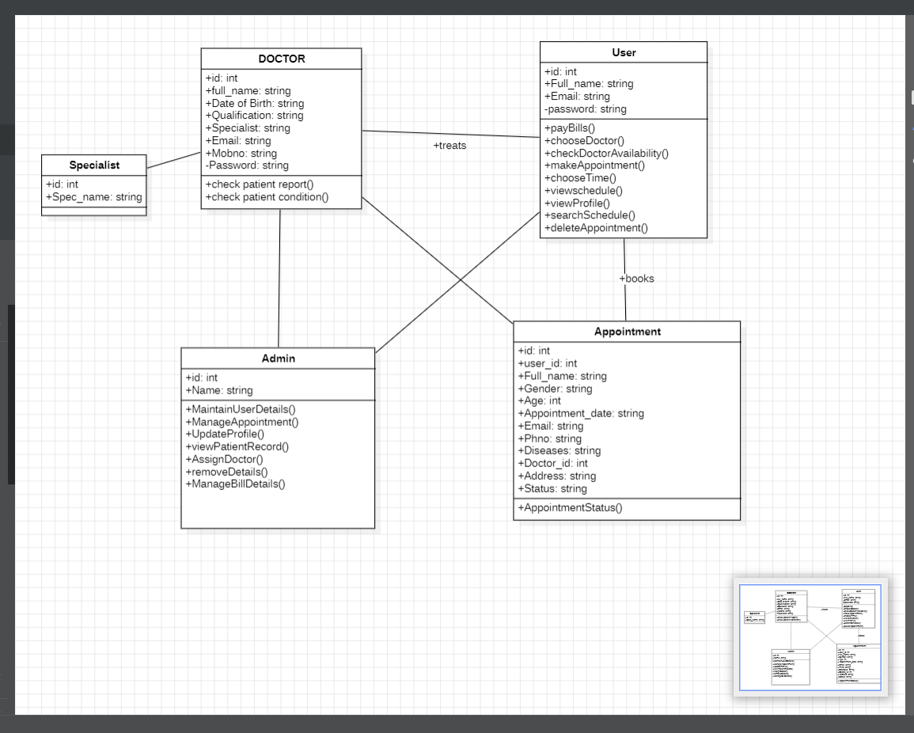
Class diagram

Slide 8
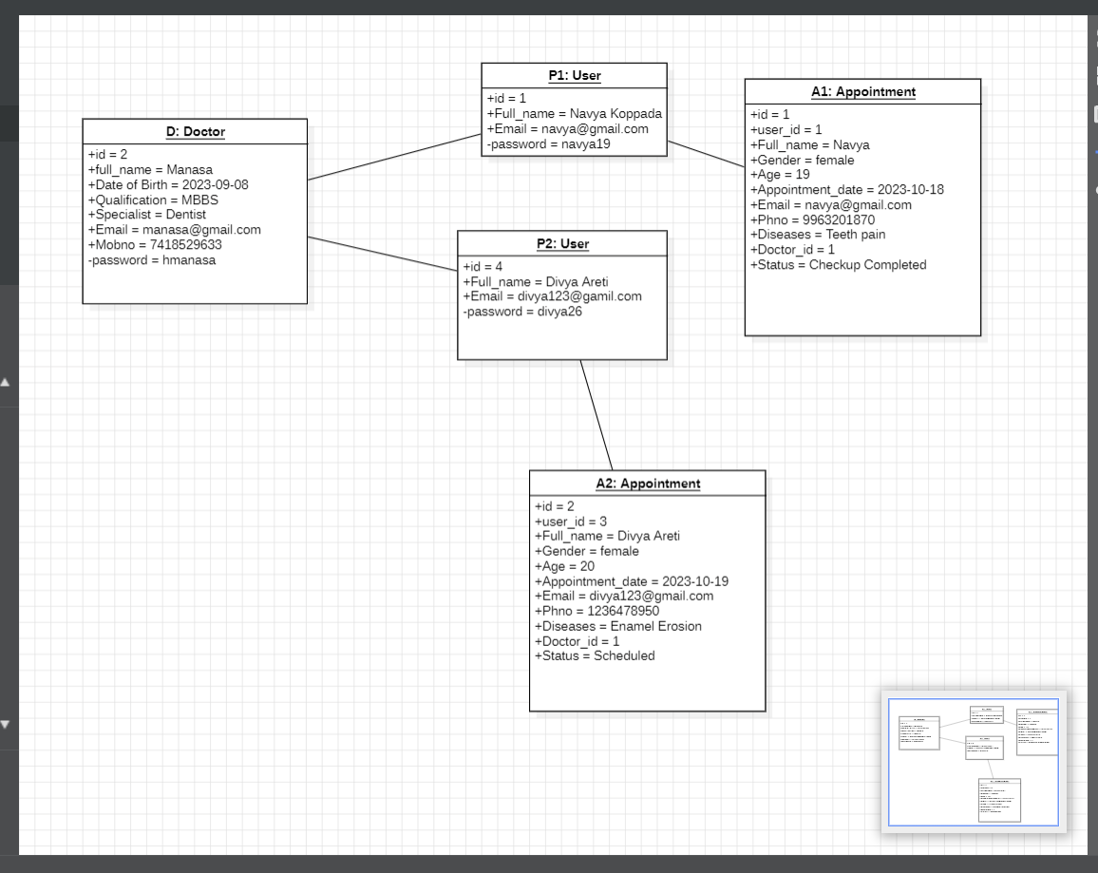
Object Diagram

Slide 9
Functional Requirements
Accounts shall able to be created by patients and doctors using their personal data.
Using usernames and passwords in a secure manner, patients and doctors shall log in to the system.
Patients shall be able to choose a doctor and make an appointment.
The availability of doctors shall be flexible, including their working days and hours.
Appointment disputes shall be handled by the system Admin, along with possible solutions.
Medical records for patients shall be available to doctors during consultations.
The prescription history shall be available to patients.

Slide 10
Non-Functional Requirements
The system shall be capable of handling numerous users simultaneously.
Appointment scheduling and loading user data shall both happen swiftly.
When more users and doctors register, the system shall be able to grow horizontally to handle the influx.
Mechanisms for safe user authentication and authorization shall be in place.
Regulations and standards pertaining to healthcare shall be followed by the system.
A system shall be established to help people and quickly resolve problems.

Slide 11
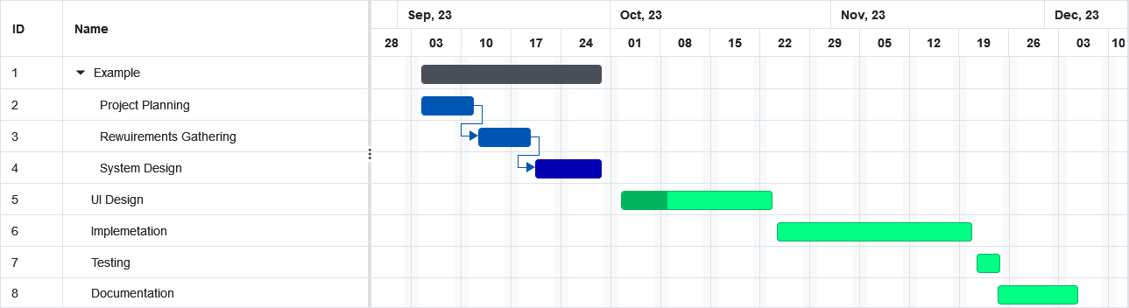
Gantt Chart

Slide 12
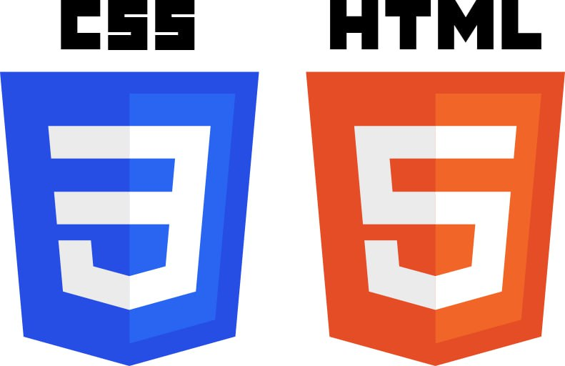


SOFTWARE REQUIREMENTS
HARDWARE REQUIREMENTS
Intel Core i5 Processor
8 GB RAM
JSP
MySQL
Servlet/Spring boot
User Interface

Slide 13
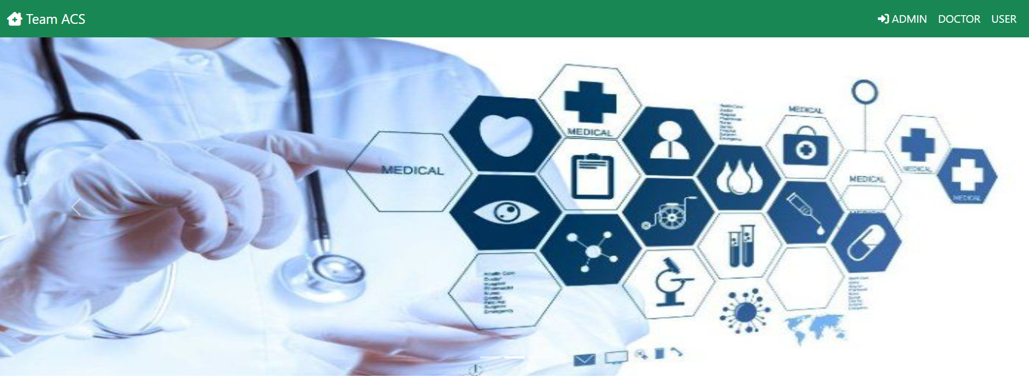
UI Design

Slide 14
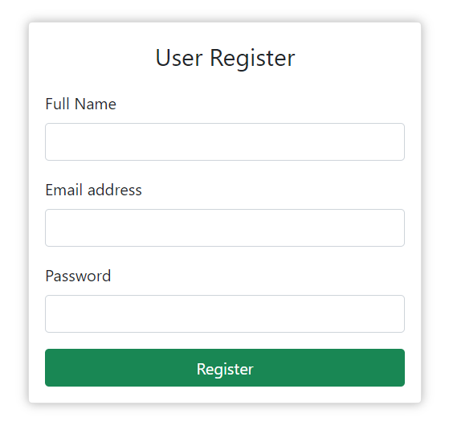
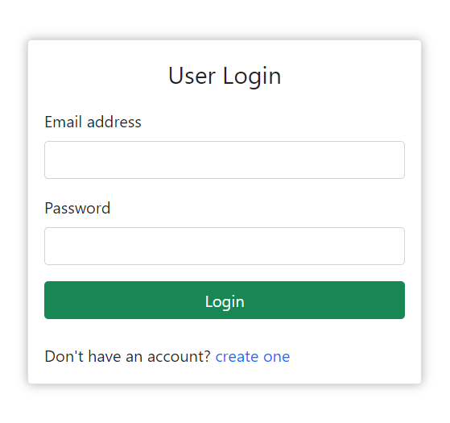
Patient or user module

Slide 15
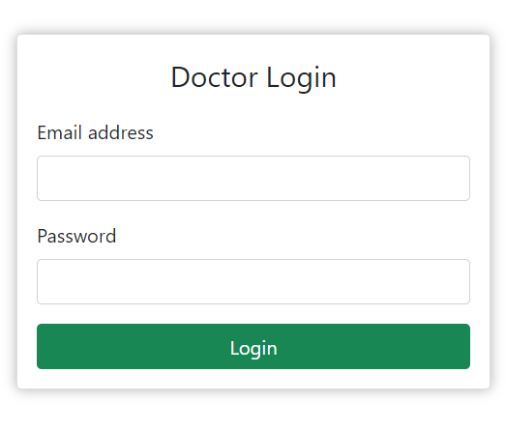
Doctor Login Page

Slide 16
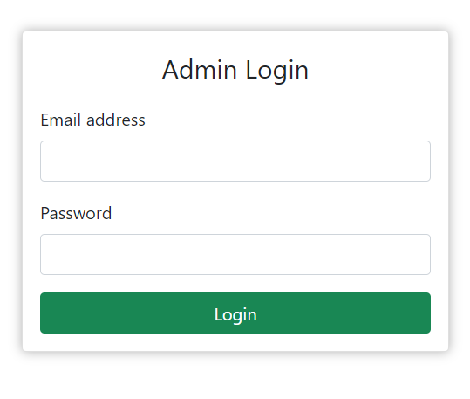
Admin Login

Slide 17
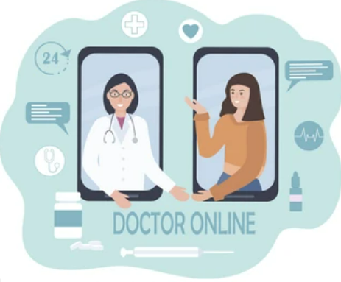
ADVANTAGES
Patient Convenience:
Easy appointment scheduling from the comfort of home.
Efficient Doctor Scheduling:
Optimized use of doctors' time and resources.
Reduced Waiting Times:
Minimized waiting room delays for patients.
Access to Specialists:
Overcome geographical barriers for specialized care.

Slide 18
FUTURE SCOPE
Make the system fully automated.
Implement security system for the project
Make the system more flexible for payment and other transaction.
Develop mobile apps for the system.

Slide 19
REFERENCES
https://www.sciencedirect.com/science/article/pii/S1877050923004076
https://link.springer.com/article/10.1007/s10729-018-9459-1
https://scholar.google.com/scholar_lookup?title=Appointment%20Scheduling%20Problem%20in%20Complexity%20Systems%20of%20the%20Healthcare%20Services%3A%20A%20Comprehensive%20Review&publication_year=2022&author=A.%20Ala&author=F.%20Chen

Slide 20


